Slide 1
AUTOMATIC CERTIFICATE GENERATOR (USING OPENCV AND PYTHON)

Slide 2
INTRODUCTION
This project automatic certificate generator using python and OPENCV implements a classic version of Certificate generator.
In this the python script automates the process of generating multiple certificates for a given list of people from a template image file.
This certificate generator includes two.txt files one for name of the candidate with date and another for coordinates files. after all this we run the python code and it will fetch all the details from these .text files and will generates the certificate.

Slide 3
TEAM MEMBERS:
NITIN KUMAR SINGH(181500434)
NIKHIL SINGHAL(181500429)
AMIT VARSHNEY(181500087)

Slide 4
PROJECT MENTOR
PRIYA AGARWAL(TECHNICAL TRAINER)

Slide 5
SOFTWARE REQUIREMENTS:
TECHNOLOGY:OPEN CV
LANGUAGE USED:PYTHON3
PYTHON IDLE AND OTHER SOFTWARES

Slide 6
HARDWARE REQUIREMENTS:
PROCESSOR USED: Intel Pentium or above
OPERATING SYSTEM: Win 7 OR above
RAM: 4GB OR above
HARDWARE DEVICES : Computer or Laptop System
HARD DISK:256GB OR above

Slide 7
IMPLEMENATION
We make this project by making two sets which is set coordinates and generate certificate so in set coordinate we set the coordinates of name and date and in case of generate certificate we select text file of names and also change default date and generate multiple certificates.
And also we required to implement various libraries such as PIL,openCV,csv,os,numpy.this libraries played an important role for automation of certificates .
First we check whether these libraries are present on system or not.we iinstall these by using pip and then import these libraries by import method.

Slide 8
LIBRARIES
PIL(Python Image Library) is used Imagefont, Imagedraw and Image.it is used for opening,manipulating and saving many different image file formats.
OpenCV is the huge open-source library for computer vision, machine learning, and image processing and now it plays a major role in real-time operation which is very important in today’s systems. By using it, one can process images and videos to identify objects, faces, or even the handwriting of a human.
The CSV module implements classes to read data in CSV format. It allows programmers to say, “write this data in the format.. the CSV formats understood by other applications or define their own special-purpose CSV formats.
The OS module allows interaction with the Operating System, either generically or specific to a particular OS. NUMPY is a Python package. It stands for 'Numerical Python'. It is a library consisting of multidimensional array objects and a collection of routines for processing of array

Slide 9
libraries
from PIL import imageFont,ImageDraw,Image
import cv2
import numpy as np
import os
import csv

Slide 10
CODING
from PIL import ImageFont, ImageDraw, Image
import cv2
import numpy as np
import os
import csv
f = open("names.txt","r")
names_list = f.read().split("\n")
#print(names_list)
f1 = open("coords.txt","r")
coordinates = f1.read().split("\n")
flag=True
for i in range(len(names_list)):
name_to_print = names_list[i]
date_to_print = "20/11/2020"#Change this date as per requirement
# Load image in OpenCV
image = cv2.imread("ce3.jpg")
# Convert the image to RGB (OpenCV uses BGR)
cv2_im_rgb = cv2.cvtColor(image,cv2.COLOR_BGR2RGB)
# Pass the image to PIL
pil_im = Image.fromarray(cv2_im_rgb)
draw = ImageDraw.Draw(pil_im)
# use a truetype font
font = ImageFont.truetype("./fonts/MLSJN.TTF", 29) #You can change fonts from list given bottom
font1 = ImageFont.truetype("./fonts/OLDENGL.TTF", 22)
# Draw the text
draw.text((int(coordinates[0]), int(coordinates[1])), name_to_print, font=font , fill='black')
draw.text((int(coordinates[2]), int(coordinates[3])), date_to_print , font=font1, fill='blue')
# Get back the image to OpenCV
cv2_im_processed = cv2.cvtColor(np.array(pil_im), cv2.COLOR_RGB2BGR)
if flag:
cv2.imshow('Certificate', cv2_im_processed) #Shows sample image
flag=False
path = ''
cv2.imwrite('./output/'+name_to_print+'.png',cv2_im_processed)
#os.startfile('output.png')
cv2.waitKey(0)
cv2.destroyAllWindows()

Slide 11
coding
from PIL import ImageFont, ImageDraw, Image
import cv2
import numpy as np
import os
import csv
f = open("names.txt","r")
names_list = f.read().split("\n")
#print(names_list)
f1 = open("coords.txt","r")
coordinates = f1.read().split("\n")

Slide 12
flag=True
for i in range(len(names_list)):
name_to_print = names_list[i]
date_to_print = "20/11/2020“
#Change this date as per requirement

Slide 13
# Load image in OpenCV
image = cv2.imread("ce3.jpg")
# Convert the image to RGB (OpenCV uses BGR)
cv2_im_rgb = cv2.cvtColor(image,cv2.COLOR_BGR2RGB)
# Pass the image to PIL
pil_im = Image.fromarray(cv2_im_rgb)

Slide 14
draw = ImageDraw.Draw(pil_im)
# use a truetype font
font=ImageFont.truetype("./fonts/MLSJN TTF"29) #You can change fonts from list given bottom
font1=ImageFont.truetype("./fonts/OLDENGL.TTF", 22)

Slide 15
coding
# Draw the text
draw.text((int(coordinates[0]), int(coordinates[1])), name_to_print, font=font , fill='black')
draw.text((int(coordinates[2]), int(coordinates[3])), date_to_print , font=font1, fill='blue')
# Get back the image to OpenCV
cv2_im_processed = cv2.cvtColor(np.array(pil_im), cv2.COLOR_RGB2BGR)

Slide 16
coding
if flag:
cv2.imshow('Certificate', cv2_im_processed) #Shows sample image
flag=False
path = ''
cv2.imwrite('./output/'+name_to_print+'.png',cv2_im_processed)
#os.startfile('output.png')
cv2.waitKey(0)
cv2.destroyAllWindows()

Slide 17
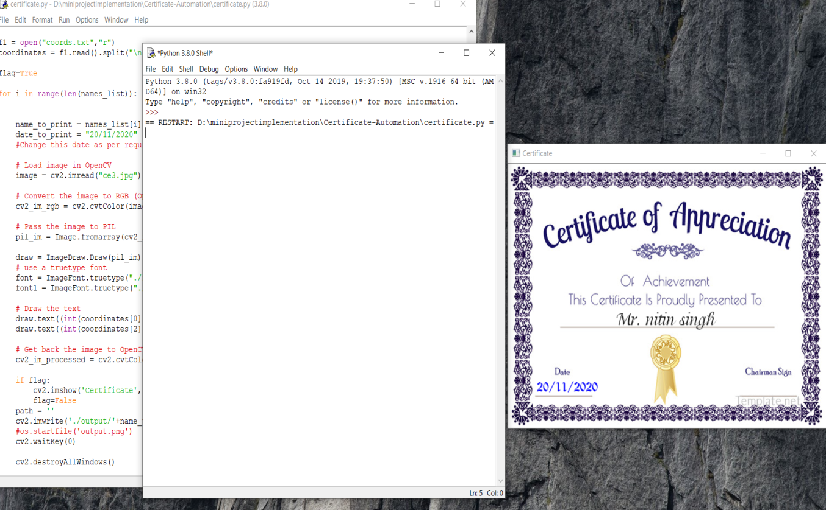
FINAL OUTPUT
RUN CERTIFCATE FILE

Slide 18
FUTURE OF PROJECT
I am a core-committee member of the University Coding Club, and hence we organize many competitions, workshops or events where we need to provide a certificate of participation to the users. To make this process automated, I decided to write a small helper script to provide me with ready to send, automatically generated certificates.
Any event usually involves a lot of participants and generating handwritten certificates for each one of them and sending them digitally is a really tedious task. Automating this job can easily save tons of time and manual work and thus also reducing the error rate. This Python script generates certificates with the persons name, reading from an excel file after loading a template certificate in the script.

